Slide 1
ACMF: An Attention Collaborative Extended Matrix Factorization Based Model for MOOC Course Service via a Heterogeneous View
Presenter：Deming Sheng
Wuhan University of Technology
School of Computer and Artificial Intelligence
Email: shengdeming@whut.edu.cn

Slide 2
0
Self-introduction
Deming Sheng
Education
Competition
GPA： 92.14% Rank：1/71
IETLS：Overall 7（Reading：8.5）
National First Prize of The 11-th China National College Student Computer Design Competition
National Second Prize of ''Huawei Cup'' The 17-th China National Post-Graduate Mathematical Contest in Modeling
Project Experience
Honors
3 fund projects
1 leader & 2 main participant
National Scholarship for Postgraduate
National Encouragement Scholarship
Research Interests
Work Experience
Educational Data Mining
Recommendation System
Natural Language Processing
Teaching Assistant & Web development Intern
President of the college's science and technology association

Slide 3
0
Self-introduction
Deming Sheng
Publications
11 papers (5 as first author) & 4 oral presentations
D. Sheng, J. Yuan, Q. Xie and L. Li. ACMF: An Attention Collaborative Extended Matrix Factorization Based Model for MOOC Course Service via a Heterogeneous View. (FGCS, JCR Q1, IF=7.187)
D. Sheng, J. Yuan and X. Zhang. Grasping or Forgetting? MAKT: A Dynamic Model via Multi-head Self-Attention for Knowledge Tracing. (SEKE 2021, CORE B, Oral Presentation)
D. Sheng, J. Yuan and X. Zhang. How MOOC Videos Affect Dropout? A Lightweight Pipeline Making Student Dropout Interpretable From Several Levels. (SEKE 2021, CORE B, Oral Presentation)
D. Sheng and J. Yuan. An Efficient Long Chinese Text Sentiment Analysis Method Using BERT_Based Models with BiGRU. (CSCWD 2021, CORE B, Oral Presentation)
D. Sheng, J. Yuan, Q. Xie and P. Luo. MOOCRec: An Attention Meta-path Based Model for Top-K Recommendation in MOOC. (KSEM 2020, CORE B, Oral Presentation)

Slide 4
1
Educational Data Mining
FGCS JCR Q1 IF=7.187
Background
Existed Issues：
Learner cognitive overload and messy course resources.
The dynamic and diverse demands of different individuals
Feature Engineering on Sparsity and Imbalanced Data
Dynamic Fusion of Multi-feature Data
Personalized and explainable recommendations for MOOC resources
Involved Technology：
Graph embedding encoder （GCN）
Node sampling algorithm (Meta-path & MCNS)
Ensemble learning
Feature-level fusion：Attention Mechanism
Model-level fusion：Matrix Factorization
Explainable learning
Model-level interpretability：Attention Weights
Instance-level interpretability：Meta-path
ACMF: An Attention Collaborative Extended Matrix Factorization Based Model for MOOC Course Service via a Heterogeneous View

Slide 5
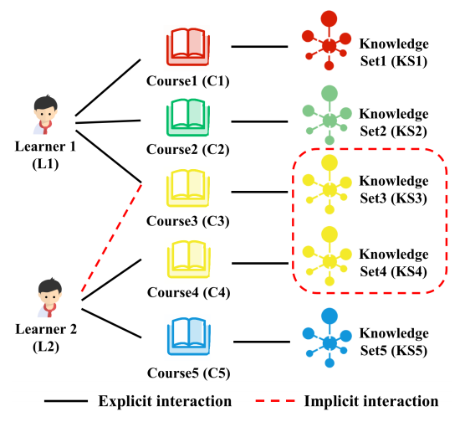
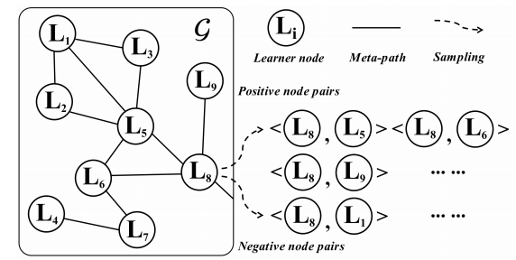
1
Educational Data Mining
Model
2. Construct a Heterogeneous Information Network (HIN)
1. Select core nodes
3. Node Simpling
Relationship Matrix
Embedding Layer
Attention Layer
Explicit
Embedding
Matrix Factorization
Recommedation
List
Node Set
Graph Embedding Encoder
Implicit
Embedding
4. The proposed model ACMF
ACMF: An Attention Collaborative Extended Matrix Factorization Based Model for MOOC Course Service via a Heterogeneous View

Slide 6
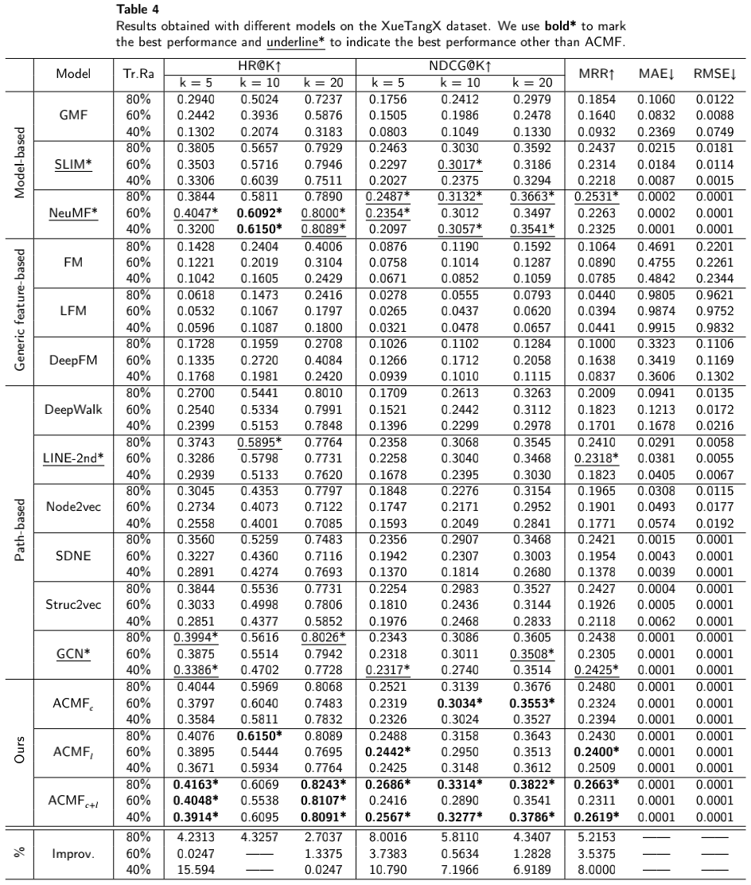
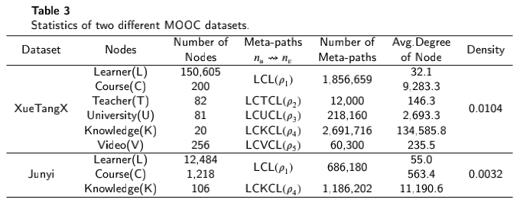
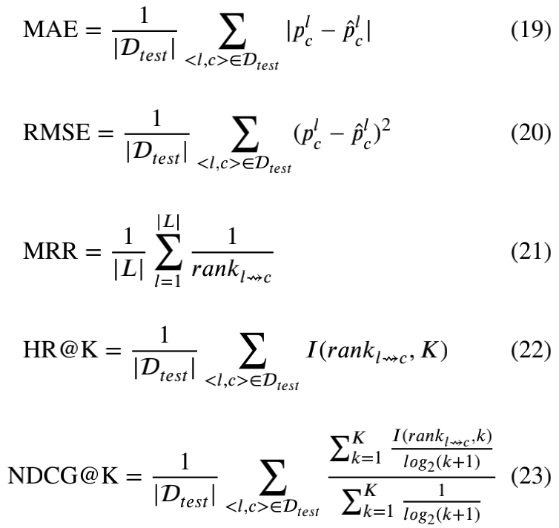
1
Educational Data Mining
Experiments
2 real-world datasets
5 evaluation metrics
2 regression metrics & 3 top-K recommendation metrics
3 kinds of recommendation methods
3 training ratios
ACMF: An Attention Collaborative Extended Matrix Factorization Based Model for MOOC Course Service via a Heterogeneous View

Slide 7
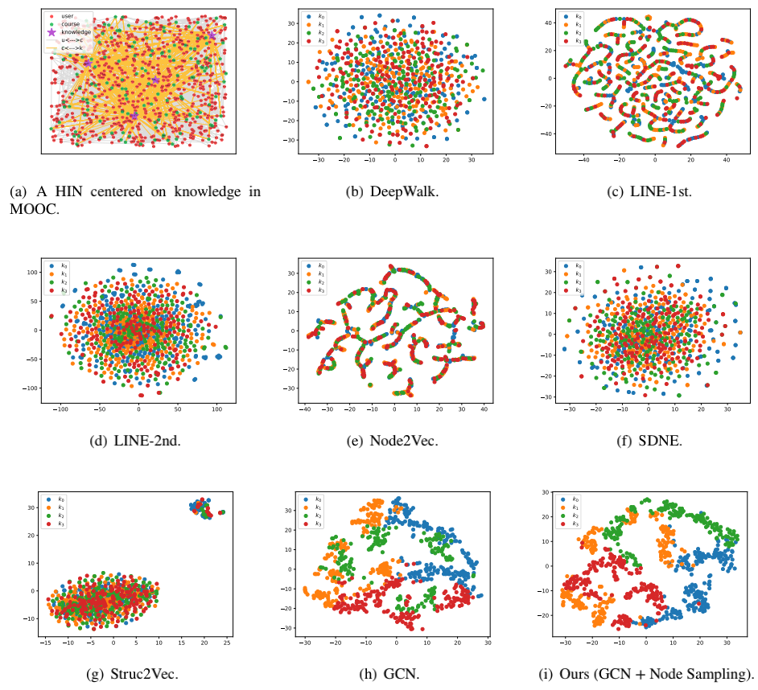
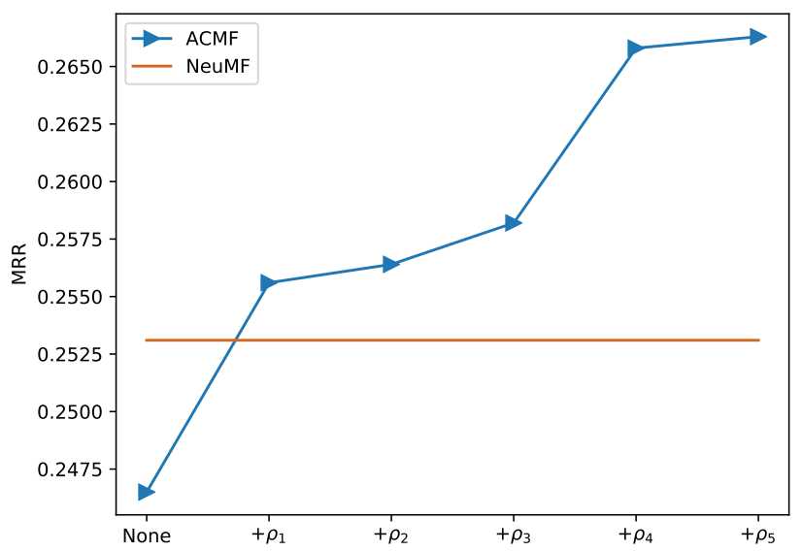
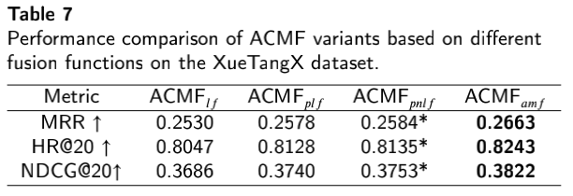
1
Educational Data Mining
Experiments
Impact of 5 diverse meta-paths
Comparison of 8 distinct embedding encoders
Comparison of 4 different fusion functions
ACMF: An Attention Collaborative Extended Matrix Factorization Based Model for MOOC Course Service via a Heterogeneous View

Slide 8
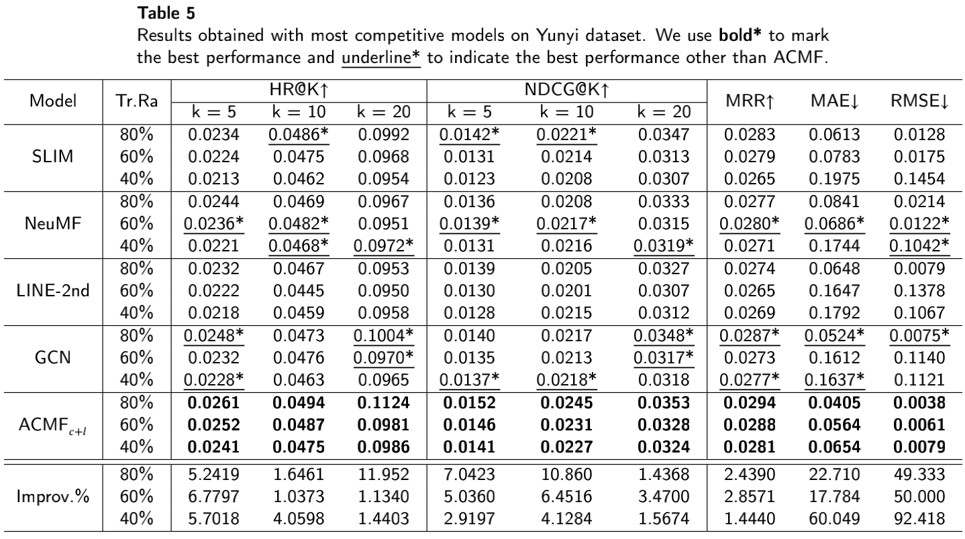
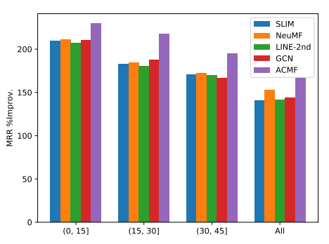
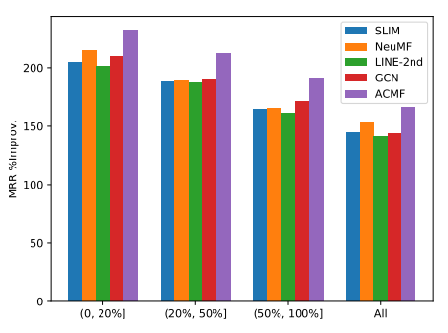
1
Educational Data Mining
Experiments
Robustness experiment
Sparsity prediction
Imbalance prediction
ACMF: An Attention Collaborative Extended Matrix Factorization Based Model for MOOC Course Service via a Heterogeneous View

Slide 9
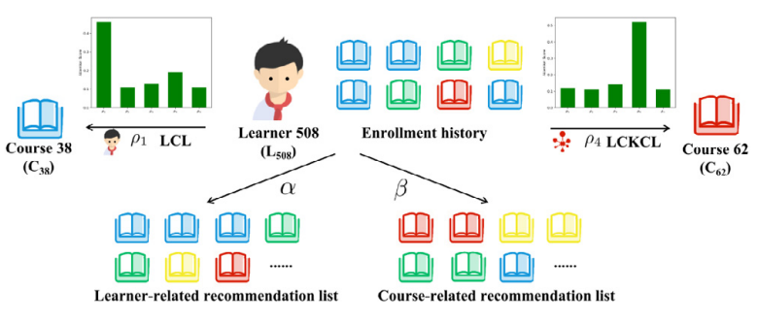
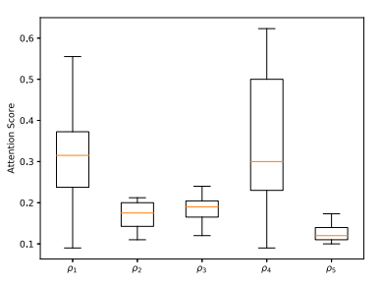
1
Educational Data Mining
Experiments
Interpretability
Model & Instance-level
Parameter sensitivity
ACMF: An Attention Collaborative Extended Matrix Factorization Based Model for MOOC Course Service via a Heterogeneous View

Slide 10
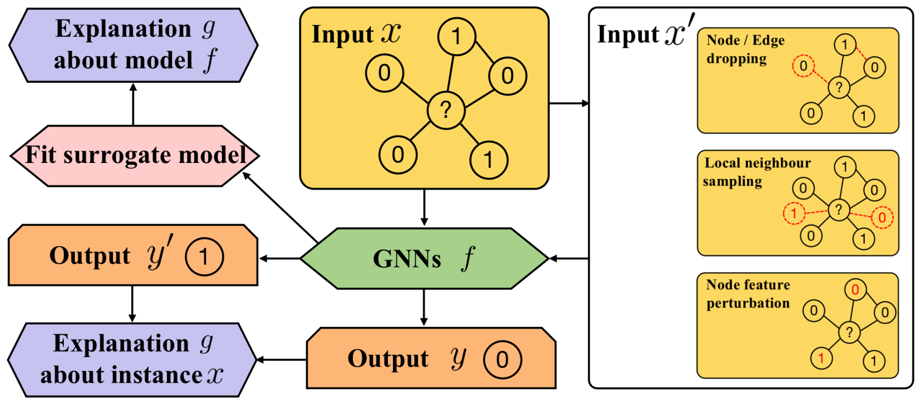
2
Future Research Interests
Potential Direction
GNN with Interpretability and Fairness
Data Analysis&Feature Engineering(CSCWD2021)
NLP tasks with Interpretability(SEKE2021)
NLP tasks with Pre-trained Models(SEKE2021)

Slide 11
Thanks for your listening
Presenter：Deming Sheng

